Slide 1
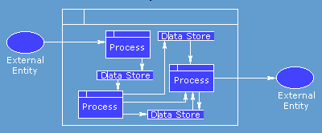
DFD
Data Flow Diagrams
"... a structured, diagrammatic technique for showing the functions performed by a system and the data flowing into, out of, and within it .."

Slide 2
Data Flow Diagram
A data flow diagram (DFD) is a graphical representation of the flow of data between processes.
It shows:
  What goes in / How it is changed / What comes out
  the processes within the system
  the data stores (files) supporting the system's operation
  the information flows within the system
  the system boundary
  interactions with external entities

Slide 3
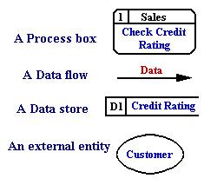
DFD Symbols
Data flow is represented by a labeled arrow
Processes are represented by labeled circles (bubbles)
Information sources and sinks are represented by boxes
Files are represented by a double line

Slide 4
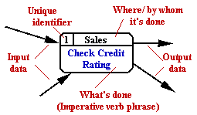
The Process Symbol
Processes transform or manipulate input data to produce output data. Except in rare cases, you can't have one without the other.
Each box has a unique number as identifier (top left) and a unique name (an imperative - e.g. 'do this' - statement in the main box area)
The top line is used for the location of, or the people responsible for, the process.
Processes are 'black boxes' - we don't know what is in them until they are decomposed

Slide 5
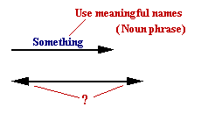
Data Flow Symbol
Data Flows depict data/information flowing to or from a process.
The arrows must either start and/or end at a process box. It is impossible for data to flow from data store to data store except via a process, and external entities are not allowed to access data stores directly.
Arrows must be named.
Double ended arrows may be used with care .

Slide 6
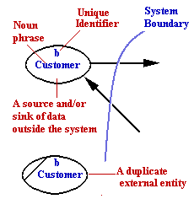
External Entities Symbol
External Entities , 'External sources/recipients, are things (eg: people, machines, organisations etc.) which contribute data or information to the system or which receive data/information from it.
The name given to an external entity represents a Type not a specific instance of the type.
When modelling complex systems, each external entity in a DFD will be given a unique identifier.
It is common practice to have duplicates of external entities in order to avoid crossing lines, or just to make a diagram more readable.

Slide 7
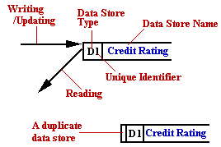
Data Store Symbols
Data Stores are some location where data is held temporarily or permanently.
In physical DFDs there can be 4 types.
D = computerised Data
M = Manual, e.g. filing cabinet.
T = Transient data file, e.g. temporary program file
T(M) = Transient Manual, e.g. in-tray, mail box.
As with external entities, it is common practice to have duplicates of data stores to make a diagram less cluttered

Slide 8


Creating a DFD
Context Diagram is an overall simplified view of the target system, which contains only one process box, and the primary inputs and outputs.

Slide 9
DFD Rules
Entities are either 'sources of' or 'sinks' for data input and outputs - i.e. they are the originators or terminators for data flows.
Data flows from Entities must flow into Processes
Data flows to Entities must come from Processes
Processes and Data Stores must have both inputs and outputs (What goes in must come out)
Inputs to Data Stores only come from Processes.
Outputs from Data Stores only go to Processes.

Slide 10
DFD Top Down Concept
Top down methodology is a process of examining an item of interest globally to start, then progressively work in more detail until all of the components of the item have been inventoried.

Slide 11
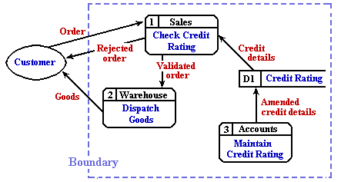
Top Level Diagram
The Top or 1st level DFD, describes the whole of the target system. It 'bounds' the system under consideration

Slide 12
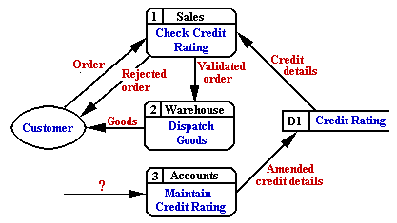
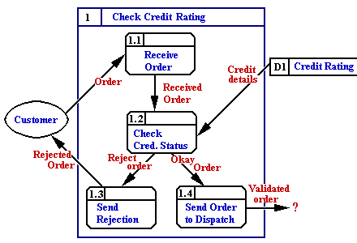
Top Down Example

Slide 13
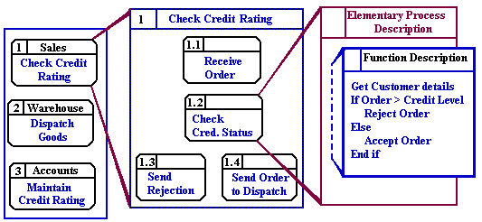
When do we stop decomposition
Decomposition stops when a process box can be described with an Elementary Process Description using ordinary English
Ask yourself if anything useful will be gained by further analysis of a process. Would any more detail influence your decisions?
If the answer is no, then there is little point in taking the analysis further.

Slide 14
DFD Principles
A system can be decomposed into subsystems, and subsystems can be decomposed into lower level subsystems, and so on.
Each subsystem represents a process or activity in which data is processed.
At the lowest level, processes can no longer be decomposed.
Each 'process' (and from now on, by 'process' we mean subsystem and activity) in a DFD has the characteristics of a system.
Just as a system must have input and output (if it is not dead), so a process must have input and output.
Data enters into the system from the environment; data flows between processes within the system; and data is produced as output from the system to the environment.

Slide 15
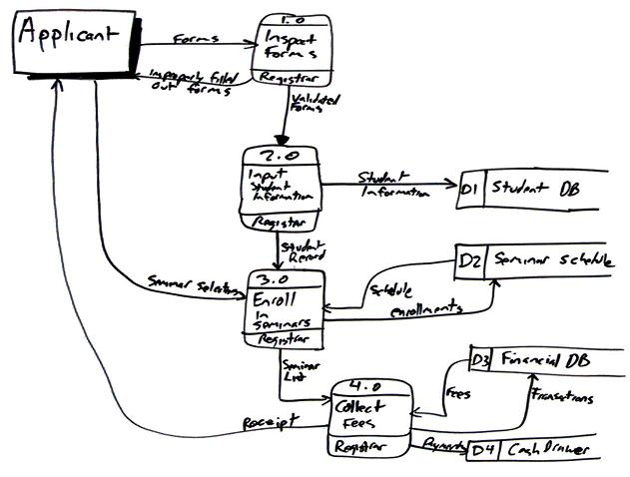
DFD
for enrolling in the university

